Slide 1



17th IEEE Conference on
Industrial Electronics & Applications
ICIEA 2022
16–19 December 2022, Chengdu, China
ICIEA22-000222
Optimization method for multi-factor tests of audible noise on UHVDC transmission lines
Penghui Zhao, Haiwen Yuan, Chengxin Liu, Hu Zhou, Hai Xu, Xiangdong, Zhang.
Penghui Zhao
Beihang University, China

Slide 2

Optimization method for multi-factor tests of audible noise on UHVDC transmission lines
Audible noise has become an important issue affecting the planning and design of ultra-high-voltage direct-current (UHVDC) transmission lines.

Slide 3
Optimization method for multi-factor tests of audible noise on UHVDC transmission lines
Step 1
Introduction
Generation mechanism and influencing factors of audible noise
Step 2
Step 3
Feature selection for multiple factors
Step 4
Orthogonal test optimization method
Step 5
Conclusion

Slide 4

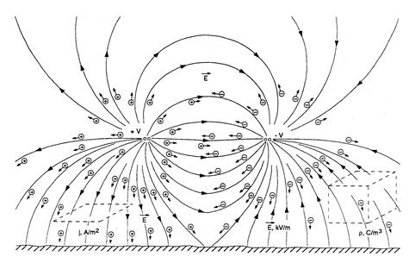
Generation mechanism and influencing factors of audible noise
When the transmission voltage is high, the strong electric field around the wire will break down the air and cause corona discharge.
The space ions move rapidly in the electric field, and the inelastic collision with the air molecules transfers the energy, causing the air molecules to vibrate, and resulting in audible noise.
Influencing factors: Transmission mode, Internal factors and External factors.
Corona discharge
Movement of ions and electrons

Slide 5
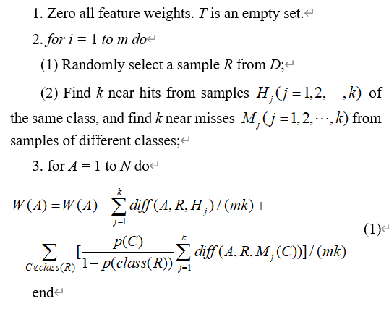
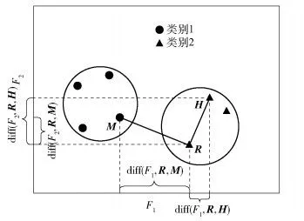
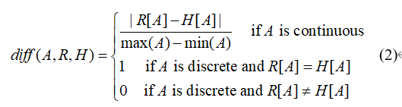
Feature selection based on ReliefF algorithm
ReliefF is a feature weighting algorithm for multi-classification problems.

Slide 6
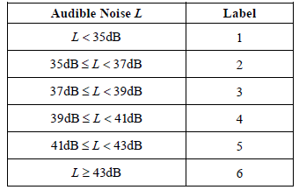
Feature selection for influencing factors
The number of the influencing factors
Classification of audible noise (A-weighted)
1-transmission voltage
2-wire diameter
3-the number of splits
4-pole spacing
5-height above ground
6-atmospheric pressure
7-temperature
8-relative humidity
9-air density
10-wind speed
11-altitude
12-ambient noise
Parameters: m=50, k=8, N=12

Slide 7
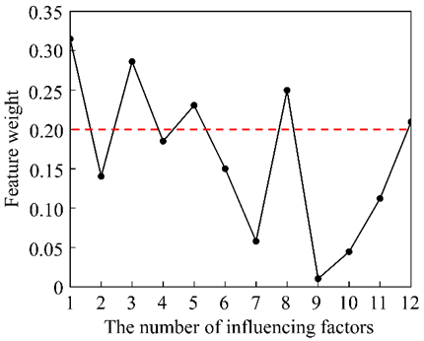
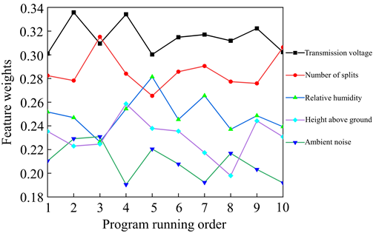
Results of feature selection
transmission voltage > number of splits > relative humidity > height above ground > ambient noise > pole spacing > atmospheric pressure > wire diameter > altitude > temperature > wind speed > air density
The feature weights of five factors when the program runs 10 times.

Slide 8
Orthogonal test optimization method
How to set the influencing factors to minimize audible noise?
Level settings of factors
Levels | Influencing Factors
 | Transmission voltage (kV) | Number of splits | Relative humidity (%) | Height above ground (m)
1 | 500 | 4 | 40 | 10
2 | 600 | 6 | 60 | 15
3 | 700 | 8 | 80 | 20
transmission voltage: 500~700kV
number of splits: 4~8
relative humidity: 40%~80%
height above ground: 10~20m

Slide 9
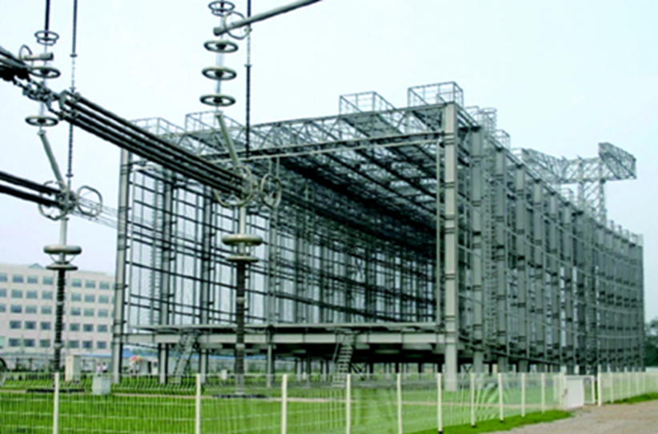

Orthogonal test optimization method
Orthogonal test scheme $L_{9}(3^{4})$
Test Order | Influencing Factors
 | Transmission voltage | Number of splits | Relative humidity | Height above ground
1 | 1 (500kV) | 1 (4) | 1 (40%) | 1 (10m)
2 | 1 | 2 (6) | 2 (60%) | 2 (15m)
3 | 1 | 3 (8) | 3 (80%) | 3 (20m)
4 | 2 (600kV) | 1 | 2 | 3
5 | 2 | 2 | 3 | 1
6 | 2 | 3 | 1 | 2
7 | 3 (700kV) | 1 | 3 | 2
8 | 3 | 2 | 1 | 3
9 | 3 | 3 | 2 | 1

Slide 10
Optimization method for multi-factor tests of audible noise on UHVDC transmission lines
Thank you for your listening!
If you have any question or advice, please contact me by e-mail zhaophl@buaa.edu.cn

