Slide 1
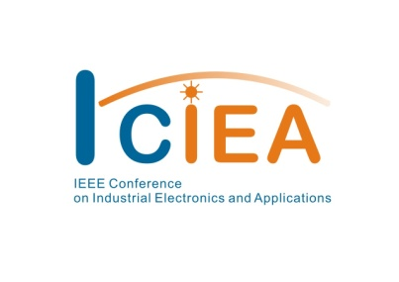
17th IEEE Conference on
Industrial Electronics & Applications
ICIEA 2022
16–19 December 2022, Chengdu, China
ICIEA22-000372
An Approach of Line Vectorization of Engineering Drawings Based on Semantic Segmentation
Yunwei Zhang
Mengyuan Zhu
Qian Zhang
Tao Shen
Baochang Zhang
Yunwei Zhang
Citc, China
Notes:
Hello everyone my name is Yunwei Zhang, a computer vision engineer in a communication design company. Recently, my colleagues and I are working on the vectorization of drawings, which usually means identifying elements in engineering drawings and labeling them as different objects. Today I’m going to talk about our work in line vectorization which is used in engineering drawings based on semantic segmentation. Thanks for watching this video, wish you all a happy day.

Slide 2
CONTENTS
Background
Overall scheme
Specific algorithm
Result & Conclusion
Notes:
This video is mainly divided into four parts. First, I will introduce the application background of this method to clarify why we need a new line vectorization algorithm; second, I will briefly introduce the overall scheme of our method, so that everyone can have a general understanding of the target of our method. Then I will start from the details of the algorithm and introduce the specific implementation of our algorithm; finally I will introduce the experimental results and conclusions of our algorithm on the drawing data set.

Slide 3
Background
Many existing engineering drawings are drawn on paper or scanned as pdf files.
Engineering design drawings often need to be redrawn or reedited over time.
Engineering component identification and vectorization reduces workload.
Line style components in engineering drawings are difficult to vectorize.
we proposed a line segment vectorization method based on semantic segmentation.
Notes:
Here is going the background of our approach. In our day-to-day communication design work, we find that many existing engineering drawings are drawn on paper or scanned as pdf files. When doing follow-up work, we usually need to refer to existing drawings, which involves a lot of redrawing and reediting. Therefore, there is an urgent need for a method that can recognize and vectorize drawings to reduce workload. In this research, we found that the common objects in the drawing can be achieved by object detection, but the line style equipment urgently needs a method that can vectorize it. So we proposed a line segment vectorization method based on semantic segmentation.

Slide 4
Overall scheme
In order to achieve the target element extraction:
We use the feature extracted from a non-local semantic segmentation algorithm based on dilated convolution and self-attention to segment the lines and endpoints in the image.
In order to achieve the extracted element vectorization:
We use the Intersection over Union (IOU) to determine whether there is a line segment connection between the two points and finally realize the line element vectorization.
Notes:
Our method proposed mainly to solve two problems. First, we need to extract of the target object. Here we use the feature extracted from a non-local semantic segmentation algorithm based on dilated convolution and self-attention to segment the lines and endpoints in the image. The second is to vectorize the extracted target, here we use the Intersection over Union (IOU) to determine whether there is a line segment connection between the two points and finally realize the line element vectorization.

Slide 5
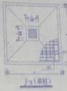
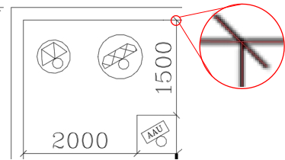
Overall scheme
Why we use semantic segmentation algorithm
Noise in real scan samples
Intelligent distinguishing elements
Why we deploy vectorization after segmentation
The result of the segmentation is a pixel binary image
The segmentation result of a line segment may have breakpoints
Notes:
In order to achieve the above goals, you may have two questions. Firstly, why we use semantic segmentation algorithm? There are indeed some mathematical method, and they can represent all elements in a binary image in vectorized form. But they cannot filter out the noise in real scan samples, even worse, they cannot distinguish semantic information in images, so they cannot intelligently and efficiently vectorize images. As shown in the enlarged part on the right, not every straight line needs to be vectorized. Secondly, why we deploy vectorization after segmentation when we have already extracted our target? Actually, the result of the segmentation is a pixel binary image, and the segmentation result of a line segment may have breakpoints. As shown in the figure on the right, the red translucent part is a visual representation of the segmentation result.

Slide 6
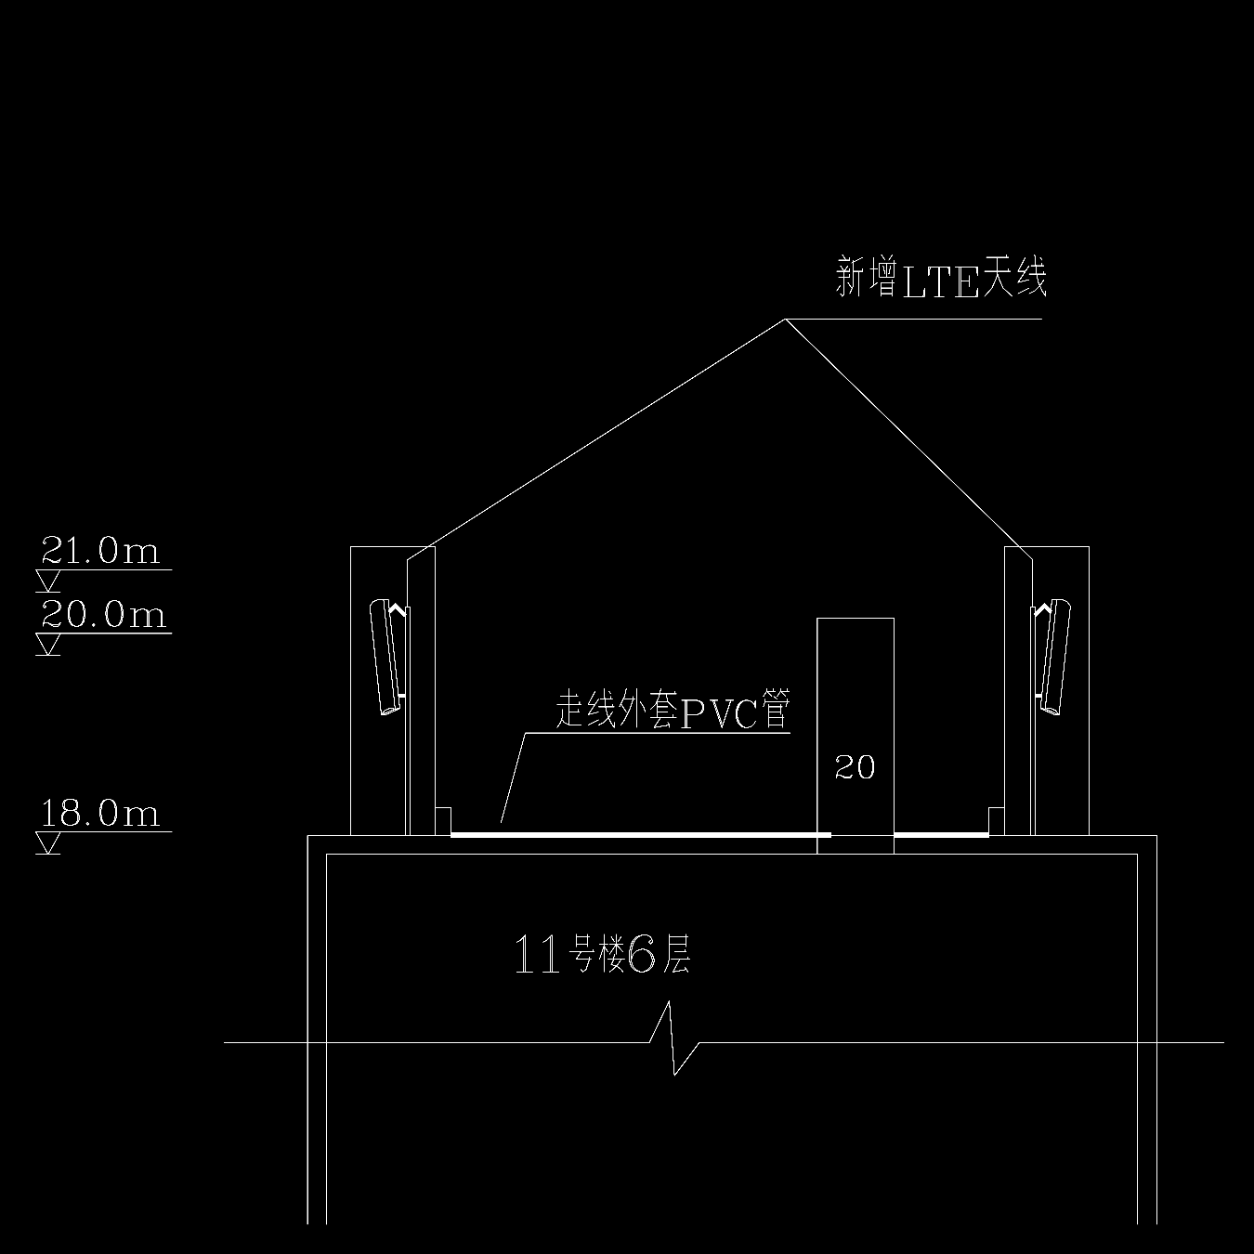
Specific algorithm
A. Semantic segmentation
In order to achieve more accurate segmentation of engineering drawings line segments, the algorithm mainly needs to solve two problems of unbalanced distribution.
Foreground and background
Foreground pixels in an image are typically one-hundredth the number of background pixels but spread over an area nearly half the size.
Horizontal and vertical
Origin
Ground truth
The line segments are long and thin, with different distributions in the horizontal and vertical directions, which is empty in the large receptive field and is not suitable for common rectangular convolutions.
Notes:
Next, I will introduce the specific details of our algorithm. Obviously, the semantic segmentation algorithm part comes first. In order to achieve more accurate segmentation of engineering drawings line segments, the algorithm mainly needs to solve two problems of unbalanced distribution. First, we will talk about the distribution of foreground and background. As we can see in ground truth image, the red foreground pixels in an image are typically one-hundredth the number of background pixels but spread over an area nearly half the size. Then in the aspect of horizontal and vertical,
the line segments are long and thin, with different distributions in the horizontal and vertical directions, which is empty in the large receptive field and is not suitable for common rectangular convolutions.

Slide 7
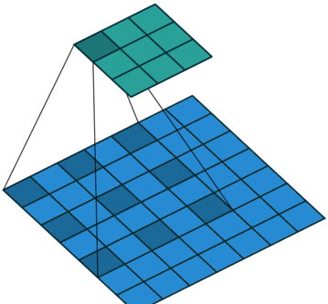
Specific algorithm
A. Semantic segmentation
Layer unit
In order to solve the sparse distribution of foreground pixels, we employ atrous convolution as our base convolution layer, which completes the aggregation of information through an expanded convolution kernel.
atrous convolution
Layers block
The line segment area is not uniformly distributed along the x and y directions. In order to better extract the context in the line segment region, we use the context semantics module named OCR, which can redistribute the weights of features to enhance the utilization efficiency of features.
Object-Contextual Representations module
Notes:
In order to solve the problem of unbalanced distribution, we have optimized both the neural network layer unit and the layers block. In order to solve the sparse distribution of foreground pixels, we employ atrous convolution as our base convolution layer, which completes the aggregation of information through an expanded convolution kernel. Considering the line segment area is not uniformly distributed along the x and y directions. In order to better extract the context in the line segment region, we use the context semantics module named OCR. In OCR module, we learn a coarse segmentation under the supervision of the ground-truth. Then we could compute the object region representation by aggregating the representations of the pixels lying in the object region, which we called Object Region Representations. With it we can compute the relation between each pixel and each object region and augment the representation of each pixel with the object-contextual representation which is a weighted aggregation of all the object region representations. With the OCR module we can redistribute the weights of features to enhance the utilization efficiency of features.

Slide 8
Specific algorithm
B. Element extraction and vectorization
We can abstract the line segment into a collection of multiple points, and the connection between the two points clearly state that the mask bitmap between the two points is activated.
Therefore, the segmentation result vectorization can be described as the following steps:
Step1. extract the line segment endpoints.
Step2. filter the connectable endpoints by line segmentation mask.
Step3. post-processing and deduplication
origin
Line & point ground truth
Notes:
In part of element extraction and vectorization. We can abstract the line segment into a collection of multiple points, and the connection between the two points clearly state that the mask bitmap between the two points is activated. Therefore, the segmentation result vectorization can be described as the following steps:
Step1 Directly extract pixels whose category is the endpoint through the semantic segmentation algorithm in the previous part.
Step2 Use the IOU of the connection between two points and the segmentation result to filter the connected endpoints with selected segments.
Step3 Removing duplicate line segments through postprocessing.

Slide 9
Result & Conclusion
Experiment datasets
We used a non-public engineering drawing line segmentation dataset.
This dataset aims to better complete the vectorization of wall elements in drawings
Implementation details
Origin
Ground truth
We employed dilated resnet101 with output_stride=16 as the backbone.
We used the polynomial learning rate policy in segmentation task.
layer4 generated coarse segmentation of the region for OCR module.
we chose to use the combined loss of Focal Loss and Dice loss that can solve the uneven distribution.
We also performed random scaling and rotation for data augmentation.
Notes:
We used a non-public engineering drawing line segmentation dataset to test our segmentation algorithm. This dataset aims to better complete the vectorization of wall elements in drawings. Here comes the implementation details:
We employed dilated resnet101 with output_stride=16 as the backbone.
We used the polynomial learning rate policy in segmentation task.
layer4 generated coarse segmentation of the region for OCR module.
we chose to use the combined loss of Focal Loss and Dice loss that can solve the uneven distribution.
We also performed random scaling and rotation for data augmentation.

Slide 10
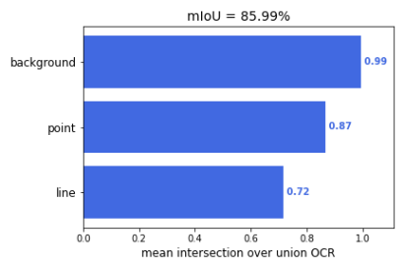
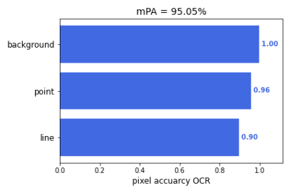
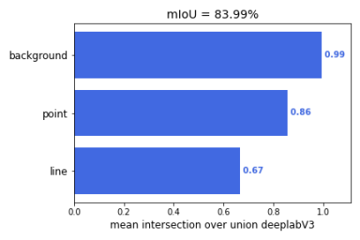
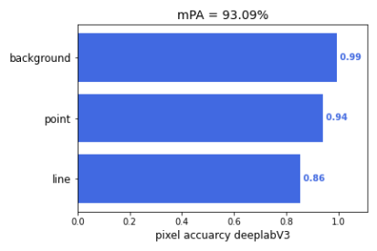
Result & Conclusion
Semantic segmentation algorithm evaluation
We compared our algorithm with deeplabv3+.
On the mIOU, this two algorithms both have excellent segmentation effects on the “background”, and our algorithm has a better effect on the segmentation of “points” and “lines”.
On mPA, our algorithm is also 2% better than deeplabv3+. Our "line" segmentation result also got better performance.
Ours
Ours
DeeplabV3+
DeeplabV3+
Notes:
We compared our algorithm with deeplabv3+.
On the mIOU, this two algorithms both have excellent segmentation effects on the “background”, and our algorithm has a better effect on the segmentation of “points” and “lines”.
On mPA, our algorithm is also 2% better than deeplabv3+. Our "line" segmentation result also got better performance.

Slide 11
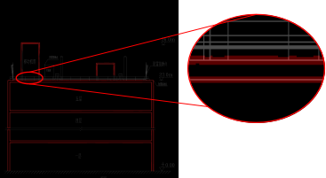
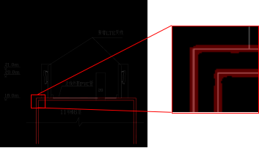
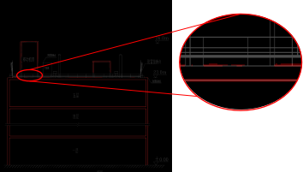
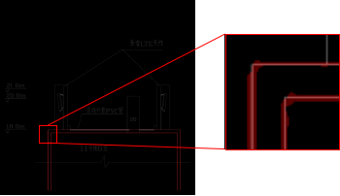
Result & Conclusion
Semantic segmentation algorithm visualization
We also made a comparison in terms of result visualization.
The results show that on longer straight lines, the segmentation results of our method are more accurate, and better continuity results can be obtained.
For the corner part of the line segment connection, our method can also ensure the accuracy of pixel segmentation to achieve a more perfect performance.
Ours
Ours
DeeplabV3+
DeeplabV3+
Notes:
We also made a comparison in terms of result visualization.
The results show that on longer straight lines, the segmentation results of our method are more accurate, and better continuity results can be obtained.
For the corner part of the line segment connection, our method can also ensure the accuracy of pixel segmentation to achieve a more perfect performance.

Slide 12
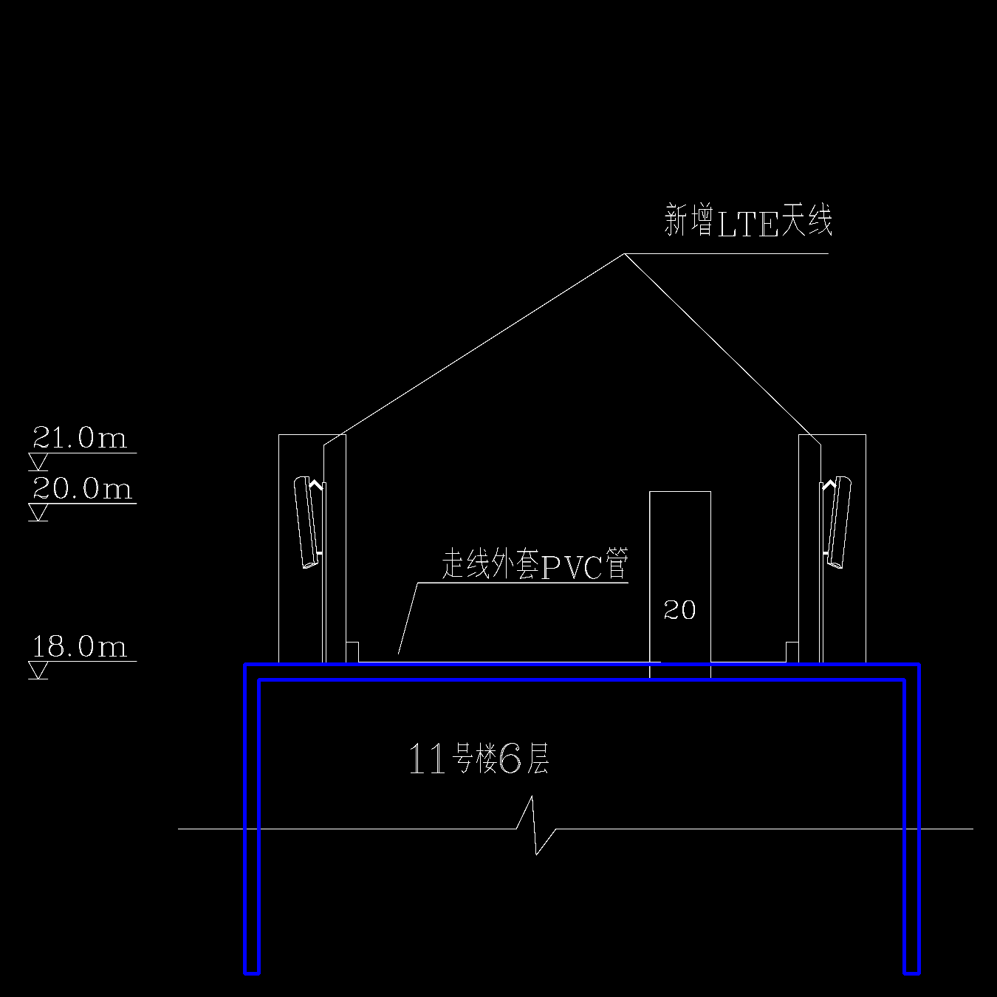
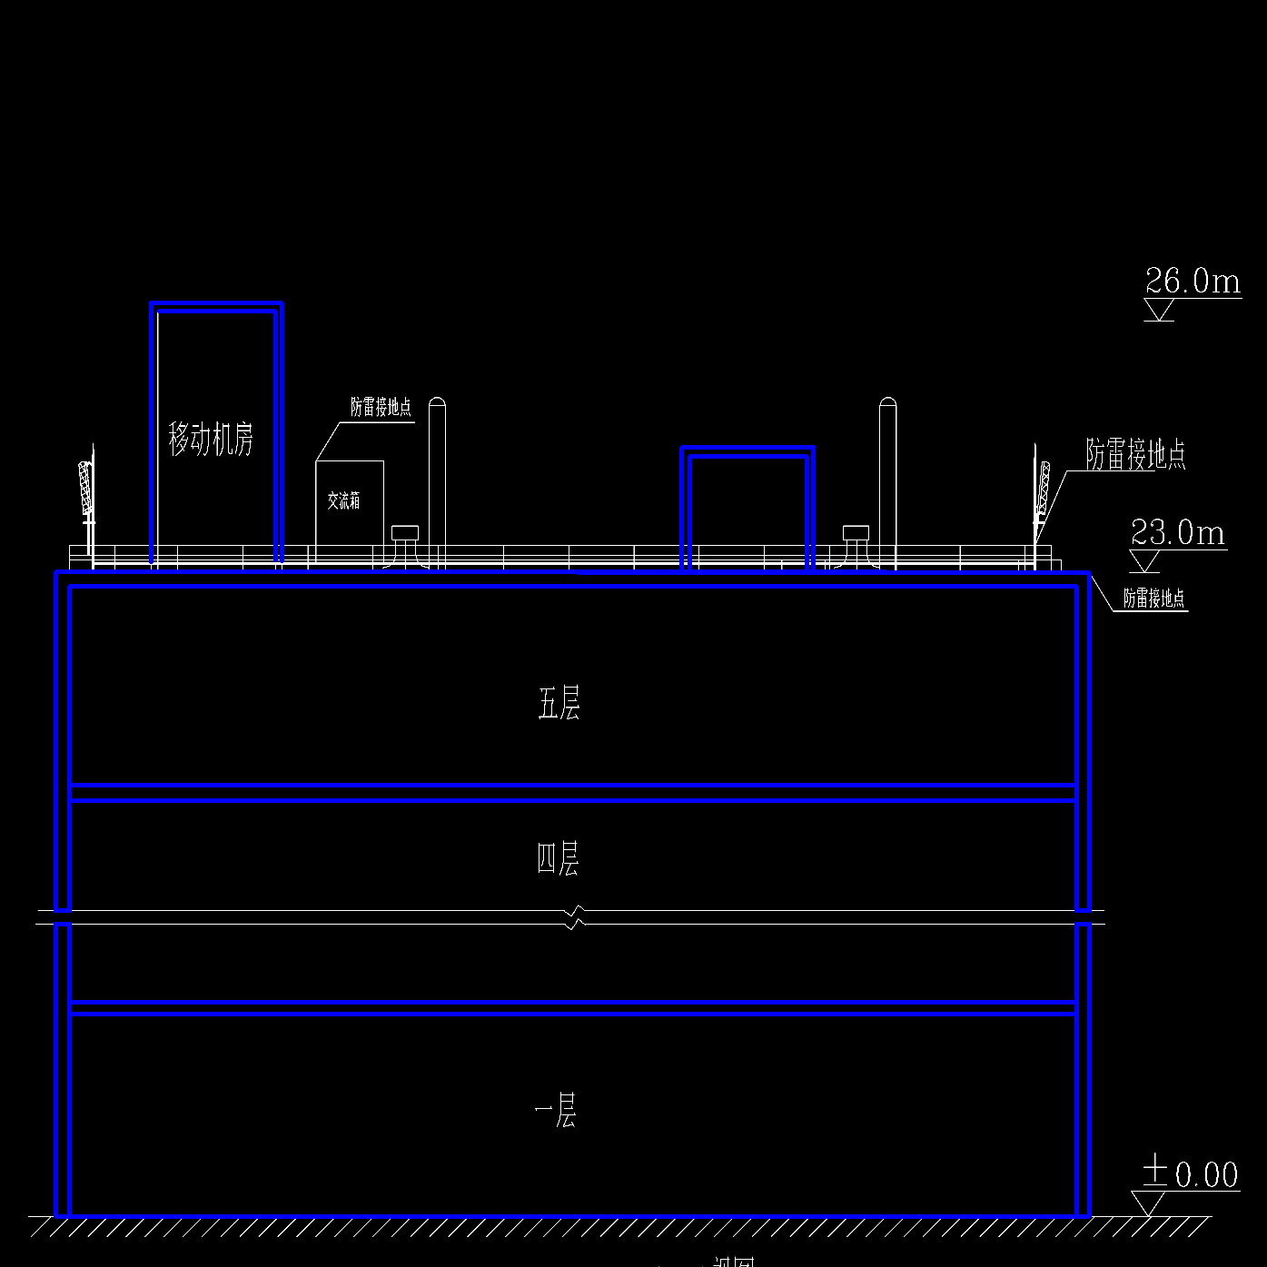
Result & Conclusion
Line segment vectorization algorithm visualization
We use the vectorization algorithm to vectorize the mask inferenced by our segmentation algorithm. The operation output results example are represented by blue line segments.
It can be observed that the vectorization algorithm performs well.
Finally, we calculate the vectorization results on the test set, turns out the accuracy rate is 81% and the recall rate is 87%.
Notes:
We use the vectorization algorithm to vectorize the mask inferenced by our segmentation algorithm. The operation output results example are represented by blue line segments.
It can be observed that the vectorization algorithm performs well.
Finally, we calculate the vectorization results on the test set, turns out the accuracy rate is 81% and the recall rate is 87%.

Slide 13
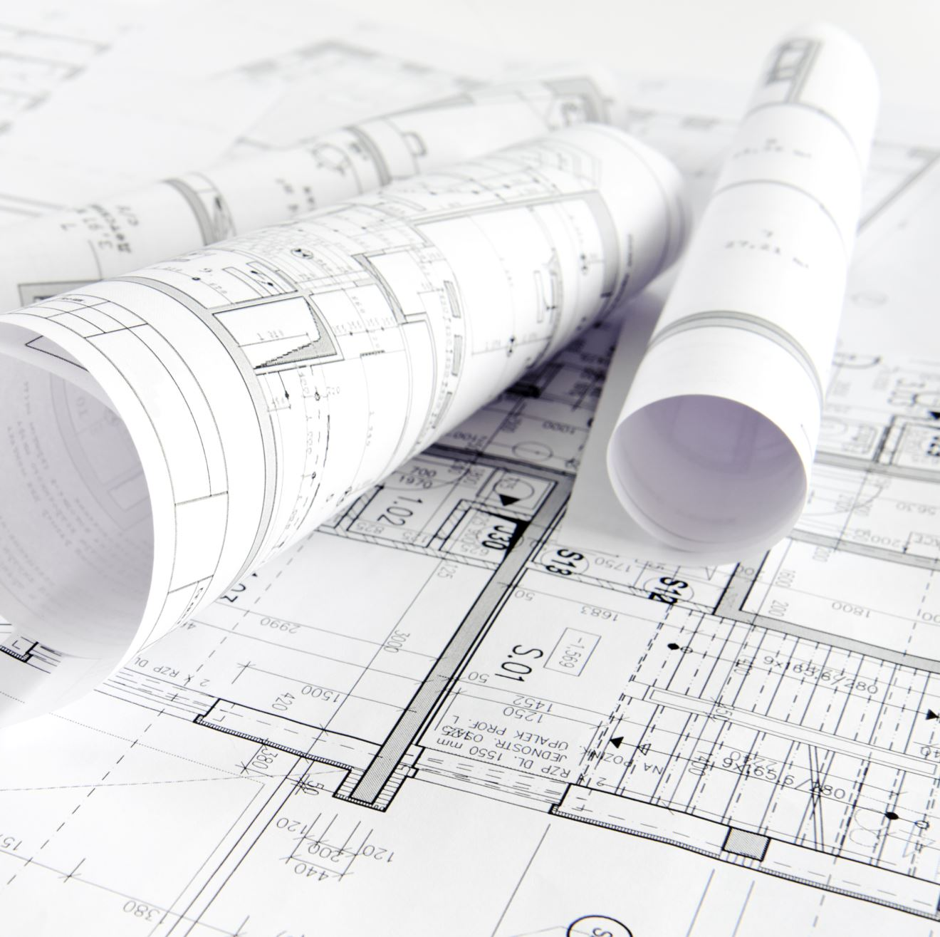
Result & Conclusion
We proposed a line segmentation and vectorization approach in the field of engineering drawings.
It shows that our approach brings consistent improvements on the engineering drawing dataset, our method can perform the vectorization task of line segment objects in engineering drawings very well.
Notes:
In conclusion, we proposed a line segmentation and vectorization approach in the field of engineering drawings.
It shows that our approach brings consistent improvements on the engineering drawing dataset, our method can perform the vectorization task of line segment objects in engineering drawings very well.

Slide 14
Thank you

